Slide 1
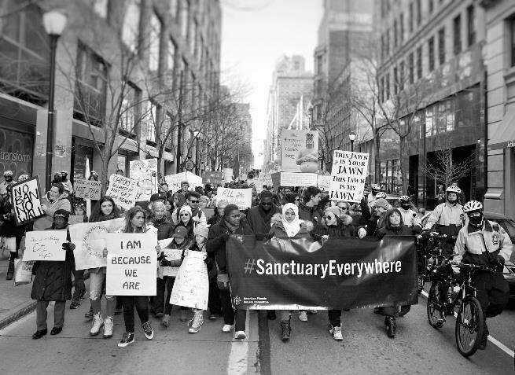

Waging Peace for 100 years
Notes:
This year we are 100 years old, we are contemplating our work in the past and preparing to lay the ground work for deep change in the coming years.

Slide 2
Our mission
Build the foundation for lasting peace
…partnering with diverse communities
…healing and restoring relationships
…and transforming unjust systems
through nonviolent action.
Notes:
Our Mission now as then was to put Quaker faith into action, to let our works speak, but not to proselytize (since the
founding Yearly Meetings could not agree on which brand of Quakerism we would be converting people to). AFSC
has been guided by this mission for 100 years, this is our Centennial year.

Slide 3
Global reach
Notes:
How do we work for peace today? Unusual for international NGO in that we work internationally AND at home—17
countries and 33 US cities. Overseas and in the US we work in places scarred by conflict, poverty, exploitation and
oppression. We have a long history of engaging with “pariah states,” Russia in the 1920’s; North Korea, Somalia,
Palestine, Zimbabwe, and Myanmar today. We see the impact of US foreign policy, domestic policy (such as
immigration) and self-serving US corporate influence on the development of that policy (as right now in Honduras)—
as AMERICAN Friends Service Committee we have a responsibility to help our country develop new approaches to
foreign and domestic policy that will serve global and domestic peace.

Slide 4
How we work
Guided by those most impacted
Focused on key issues
Supporting the rising generation of young leaders for nonviolent social change
Changing the narrative on militarism & violence
Notes:
We accompany those with whom we work, our efforts arise from partnerships and relationships deep in the communities out of which arise our efforts around our key issue areas, which include
Ending mass incarceration/healing justice
Ending discrimination
Working for immigrant rights
Establishing just economies
Building peace
We try to work at the roots of issues understanding that peace is not possible without justice and equity.
We also have been focused in the last five years on two strategic initiatives, fostering youth leadership and changing the narrative on militarism and war.

Slide 5
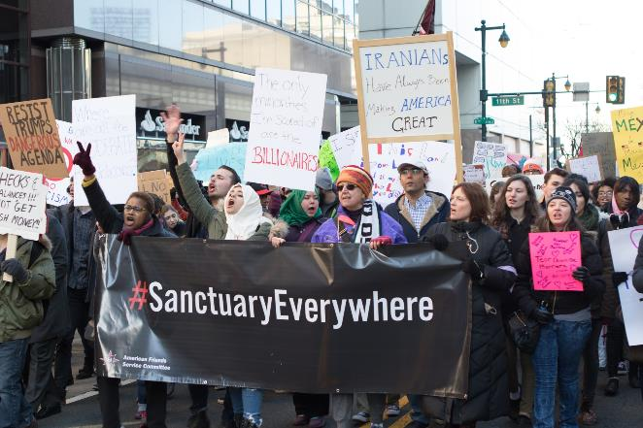
100 years of action
.
Notes:
We know that peace and safety are built on foundations of love and inclusion, not oppression and discrimination. As we partner with people across the country who are challenging fear and hate, we offer hope—hope that compassion will win out over fear, and that together we can create the open, welcoming communities we all deserve.

Slide 6

Honoring 100 years
.
Notes:
We know that peace and safety are built on foundations of love and inclusion, not oppression and discrimination. As we partner with people across the country who are challenging fear and hate, we offer hope—hope that compassion will win out over fear, and that together we can create the open, welcoming communities we all deserve.
Show the video here
https://www.youtube.com/watch?v=U4FbLz2WnUI&feature=youtu.be

Slide 7
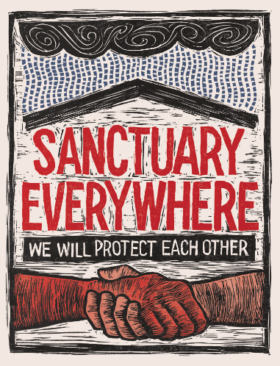
Justice for all…?
.
Notes:
We are unshakable in our commitment to peace, justice, and equality. We will resist any attempt to sacrifice the rights of the marginalized. We will question any efforts to add comfort to the privileged. We will speak truth to power – as often as it takes to be heard. We will build bridges for dialogue and reconciliation. And we will stand with groups fearing violence and persecution and support their movements to overcome injustice.
Sanctuary Everywhere is a new campaign that reflects our work to provide safety and a sense of agency for all the communities in which we work. We provide tools and training to help groups and allies resist and advocate for better alternatives. You can find many resources at www.asfc.org/SanctuaryEverywhere

Slide 8
Marking the occasion
Sharing stories: Peace works
Special issue of Friends Journal
Plenary, workshops and events at the FGC Gathering
Full scale and banner exhibit
Notes:
Giving people authentic, meaningful experiences with AFSC.
Friends Journal issue April, 2017, submissions due Jan. 2, 2017
AFSC will offer 4 workshops, full afternoon events schedule, interest groups and sponsor a featured plenary presentation with Sa’ed Atshan, Sandra Tamari, and Dalit Baum at the FGC Gathering.
As we celebrate the past, we are building the foundation of spirit-guided transformative peace work for the next era of social change.

Slide 9
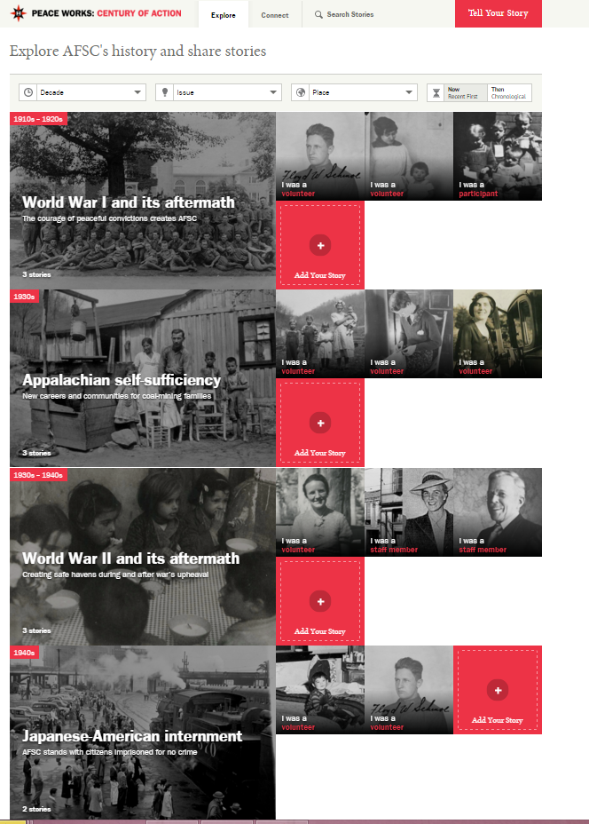
Peace Works
Chronicles eras of AFSC’s work
Offers a way to connect and remember
Share your story or invite someone else to share
Notes:
Peace Works provides an opportunity to share stories as a key way to re-engage, to remember and acknowledge the contributions so many have made.
Add your story.
210 stories today!

Slide 10
Exhibit
Notes:
Give deeper context to the work AFSC does
Building Peace, Just Economies, Ending Discrimination, Immigrant Rights, Addressing Prisons
Reach tens of thousands of people who may never know about AFSC
Use AFSC work to engage, provoke and inspire people to take action
Launches January 2017 in Philly at the African American History Museum
Opens on MLK weekend/during their busiest season
Two versions of exhibit
Large, museum quality exhibit
4 copies of banner exhibit that will travel to regions and YMs

Slide 11
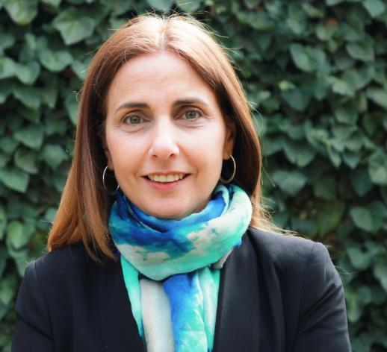
New Leadership
Notes:
As the American Friends Service Committee celebrates its 100th year, we are pleased to announce the appointment of Joyce Ajlouny as our next general secretary beginning Sept. 1, 2017.
A transformative Quaker leader, Joyce brings to AFSC a depth of experience in strategic planning, financial and personnel management, fundraising, and communication spanning 27 years.
She is currently employed by Friends United Meeting and serves as the director of the Ramallah Friends School in Palestine, where she has led a diverse staff of over 170 educators and administrators for the past 13 years. She spent the prior 14 years working in international development focusing on minority and refugee rights, gender equality, economic development, and humanitarian support. She served as the country director for Palestine and Israel with Oxfam-Great Britain, chaired the Association of International Development Agencies there, and worked as a program officer and project manager at various United Nations agencies. Joyce holds a master’s degree in Organizational Management and Development from Fielding Graduate University in California.

Slide 12
Staff Changes
After the 2009 recession and consequent budget cuts, AFSC grew back too quickly.
Last year we realized that our current budget is unsustainable.
To correct this we have increased our fundraising efforts and cut expenses to be more in line with income.
With the Trump administration and the deeper targeting of communities, it is particularly difficult to cut back on programs, and the changes we seek will only come about through engaged, long-term work. We needed to make these cuts to guarantee the future of the entire AFSC.
Notes:
Answering about why cuts were needed: • Like many nonprofits, AFSC took a big hit in the 2009 recession and we committed to grow back, to be able to do more work in and for communities around the world, as the economy recovered. • We did grow back quickly, but too quickly, and we were too optimistic about the speed of our recovery. Last year, we realized that our current budget for all our work is not sustainable. • To correct for this, we have increased our fundraising efforts and have made some difficult budget cuts to keep expenses in line with income. • With the Trump Administration threatening the well-being of so many people, it is a particularly hard time to close programs and make cuts. While it is important to stand up to challenge militarism and protect our human rights today, the crucial changes we seek will only happen through engaged, long-term work. We needed to make these cuts to guarantee the future of the entire American Friends Service Committee so we can change the systems and social narrative that justifies violence, militarism, and oppression.

Slide 13
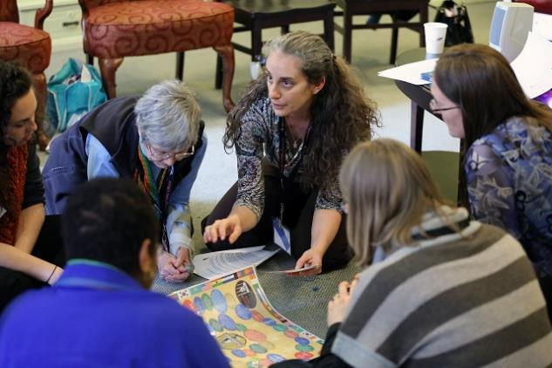
Partnering with Friends
Notes:
Partners in Spirit-led action: Here are 12 ways to engage your Quaker meeting or church with AFSC. By engaging with Friends and providing resources for spiritually-grounded social justice work, the program seeks to support a movement of Friends working for lasting peace with justice.

Slide 14
Friends Engage
Acting in Faith (afsc.org/friends)
QuakerSpeak
Calls for Spirited Action
Testimonies booklet
5 thing you can do
39 Questions for white people
Let your life speak story packet
AFSC staff member visits
Acting in Faith w/AFSC at the FGC Gathering
Join the Quaker Palestine Israel Network
Quaker social change ministry
Celebrate the Centennial with us
Notes:
11 ways your meeting/church can work with AFSC for just peace
1. Share a post from AFSC's Acting in Faith blog with your meeting or church.
Don't forget to sign up to receive updates from the Acting in Faith newsletter, and read back issueshere. Reprint an Acting in Faith article in your newsletter or share new posts on your meeting/church's social media site. Some posts would be excellent reading material for a study session on spirit-led activism, on undoing racism or on other topics.
2. Watch and share an AFSC QuakerSpeak video.
In 2015 AFSC partnered with Friends Journal to create three videos on AFSC's issue areas. Each video is followed by links to resources for deeper learning and action. The videos are A Quaker call to action on Israel Palestine, How Quakers can help end mass incarceration, and Quakers and migrant justice.
3. Dial in to our monthly Calls for Spirited Action
Learn more about AFSC's different areas of work and hear how Quakers have successfully taken on these issues in their meeting or church.
4. Connect spirit to social witness using our Introduction to the Quaker Testimonies.
This resource seeks to distill and share the Quaker testimonies that underlie both what we do and how we aspire to do it, with thoughts about living out each testimony, queries, and quotations for reflection. We've also created a study guide to provide Quaker meeting/churches with ways to interact with the material in Adult Religious Education settings or with high school Friends.
5. Explore our "5 things your congregation can do" pages and encourage your meeting to engage with AFSC Key Issues.
Did you know that AFSC Programs and Friends Relations have created "5 things your congregation can do" pages for a variety AFSC Key Issues: Healing Justice, Immigrant Justice, and Israel/Palestine. We are offering 5 things you can do to Humanize, not Militarize to accompany our traveling exhibit. Join the Quaker Network to end Mass Incarceration or the Quaker Palestine Israel Network.
6. Host the traveling art installation 39 Questions for White People and engage Friends in conversations about undoing racism drawing from posts at Acting in Faith.
39 Questions for White People is an art piece by Naima Lowe, which explores whiteness and asks open questions that prompt dialogue on racism and white privilege. Read several undoing racism posts from Acting in Faith as a meeting/church to deepen your exploration.
7. Share the "Let your Life Speak" story cards with family and Friends, featuring stories of courageous people working with AFSC for change.
AFSC Friends Relations will inspire you and your family with the "Let your Life Speak" project. Liaisons can share the cards with members of your meeting/church and facilitate a discussion about the stories motivate you to take courageous action or support others who are doing so. Participants will also be encouraged to contribute monetarily or join in to create change.
8. Bring an AFSC staff member to present at your monthly, quarterly, or yearly meeting or church.
Contact friends@afsc.org to learn more.
9. Participate in an AFSC workshop or other AFSC organized program at the FGC Gathering. Attend a conference co-sponsored by AFSC at Pendle Hill on restorative justice.
Find our offerings at the FGC Gathering for July, 2016 here. AFSC staff will be co-leading five workshops and offering a full afternoon events schedule at the FGC Gathering in July, 2016. In March, 2016, we are partnering with Pendle Hill to host Beyond Crime and Punishment: Fostering Transformative Justice in communities, a conference for Friends and others.
10. Invite members or attenders of your meeting/church to share a story at our Peace Works: Century of Action website.
For 100 years, we have worked together for peace and justice. Explore these stories and add your own, or encourage a Friend to do so, as we celebrate AFSC's past and future. For more information, please contact peaceworks@afsc.org.
11. Learn more about the Quaker Social Change Ministry pilot program and consider joining with a small group in your meeting/church.
AFSC is excited to bring the Quaker Social Change Ministry pilot program to Friends. Developed by three Unitarian Universalist ministers in the Denver area, Quaker Social Change Ministry is a Spirit-led, relationship based approached to social change work. You can find more at www.afsc.org/qscm or reach out to Lucy at lduncan@afsc.org.
12. Celebrate the Centennial with us – find out more at www.afsc.org/100.

Slide 15
Quaker social change
ministry
Faith based small group social justice ministry for collective action
Groups come together, form a covenant, share spiritual practices, tell stories
Rooted in accompanying communities most impacted by injustice, following their lead
Creates sustainable groups for the long haul
Working to create beloved community
Reach out for information at friends@afsc.org
Notes:
A large percentage of our meeting has attended at least one Quaker Social Change Ministry meeting. We have gotten to know each other better and are much more aware of each other’s social justice work. We have found the suggested agenda, including spiritual practices and evaluating our stories from a spiritual perspective, to be very enlightening as well as energizing.
Jeff Kisling
North Meadow Circle of Friends
Most of us are familiar with Friend’s history of jumping into situations and trying to provide leadership which often ends up not being what the impacted community needed. This can end up causing more harm than good, and is why activists so often find themselves discouraged, often giving up the work entirely. QSCM helps Friends change the focus to the impacted community, because the people there are the ones who know the factors and people who are impacting their situation. The impacted community has a better idea of what the driving issues are, and thus know what solutions are needed, and probably have a good idea of how to create those solutions. Our role is to be ready to do what we are asked to do, when we are asked to do it.
Jeff Kisling
North Meadow Circle of Friends

Slide 16

“Peace is the generous, tranquil contribution of all to the good of all”
- Bishop Oscar Romero
Notes:
Join AFSC in doing powerful, Spirit-led social justice organizing that is grounded in Quaker principles, accountable to communities most impacted, and models the Beloved Community we wish to co-create.

